Slide 1
purifAI
Machine Learning for SPE Method Prediction
Created by Jen Amis, Luke Perrin, Teresa Trann, Yingying Cheung

Slide 2
Overview
Background
Purpose
Goal

Slide 3
Problems to solve
Which properties of a compound’s structure are relevant to include as features in a machine learning model to predict the optimal SPE method for compound purification?
Which machine learning model will perform best for predicting optimal SPE method for compound purification?
1
3
2
Can a machine learning model be developed that has sufficiently high accuracy, precision, and sensitivity for predicting optimal SPE method for compound purification?
4

Slide 4

Data Source
This project utilizes datasets provided by the data team at the automated chemistry platform. The first dataset lists compounds tested by the platform over the past two years and includes compound properties such as molecular weight, topological polar surface area (TPSA), quantitative estimate of drug-likeness (QED), among many others that may be relevant to predicting the appropriate SPE method to use for compound purification. The second dataset includes the status of testing for each compound and the SPE method used for each compound that has completed the purification stage. Each compound is identified by a unique structure ID, and proprietary information about the actual structure of the compound has been excluded from the datasets.

Slide 5

Database
A relational database (RDS) was created in Amazon Web Services (AWS), and connected to pgAdmin14. This Postgres database is hosted on the cloud, which can be accessed by anyone with credentials using pgAdmin14. Data was cleaned by Pandas, and stored in AWS S3 bucket. We call the data from RDS by using SQLAlchemy.

Slide 6
MACHINE LEARNING

Slide 7
DATA EXPLORATION
.

Slide 8
MACHINE LEARNING MODEL
.

Slide 9
DASHBOARD

Slide 10
Data analysis
Using Jupyter Notebook ….. to create a series of graphs
These graphs help visualize the features importance in the model, and help to distinguish the most important features

Slide 11
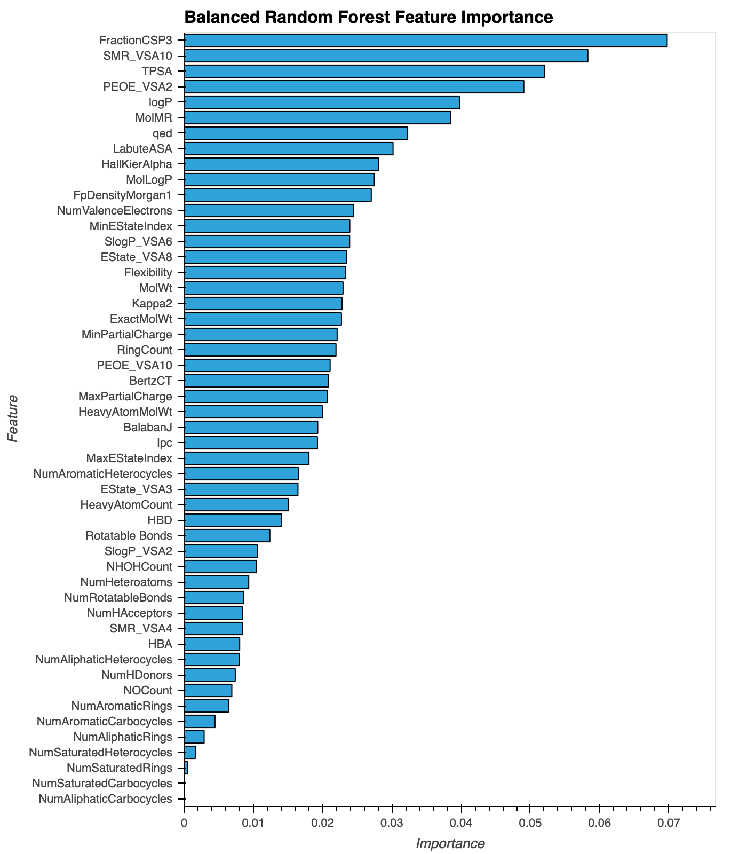
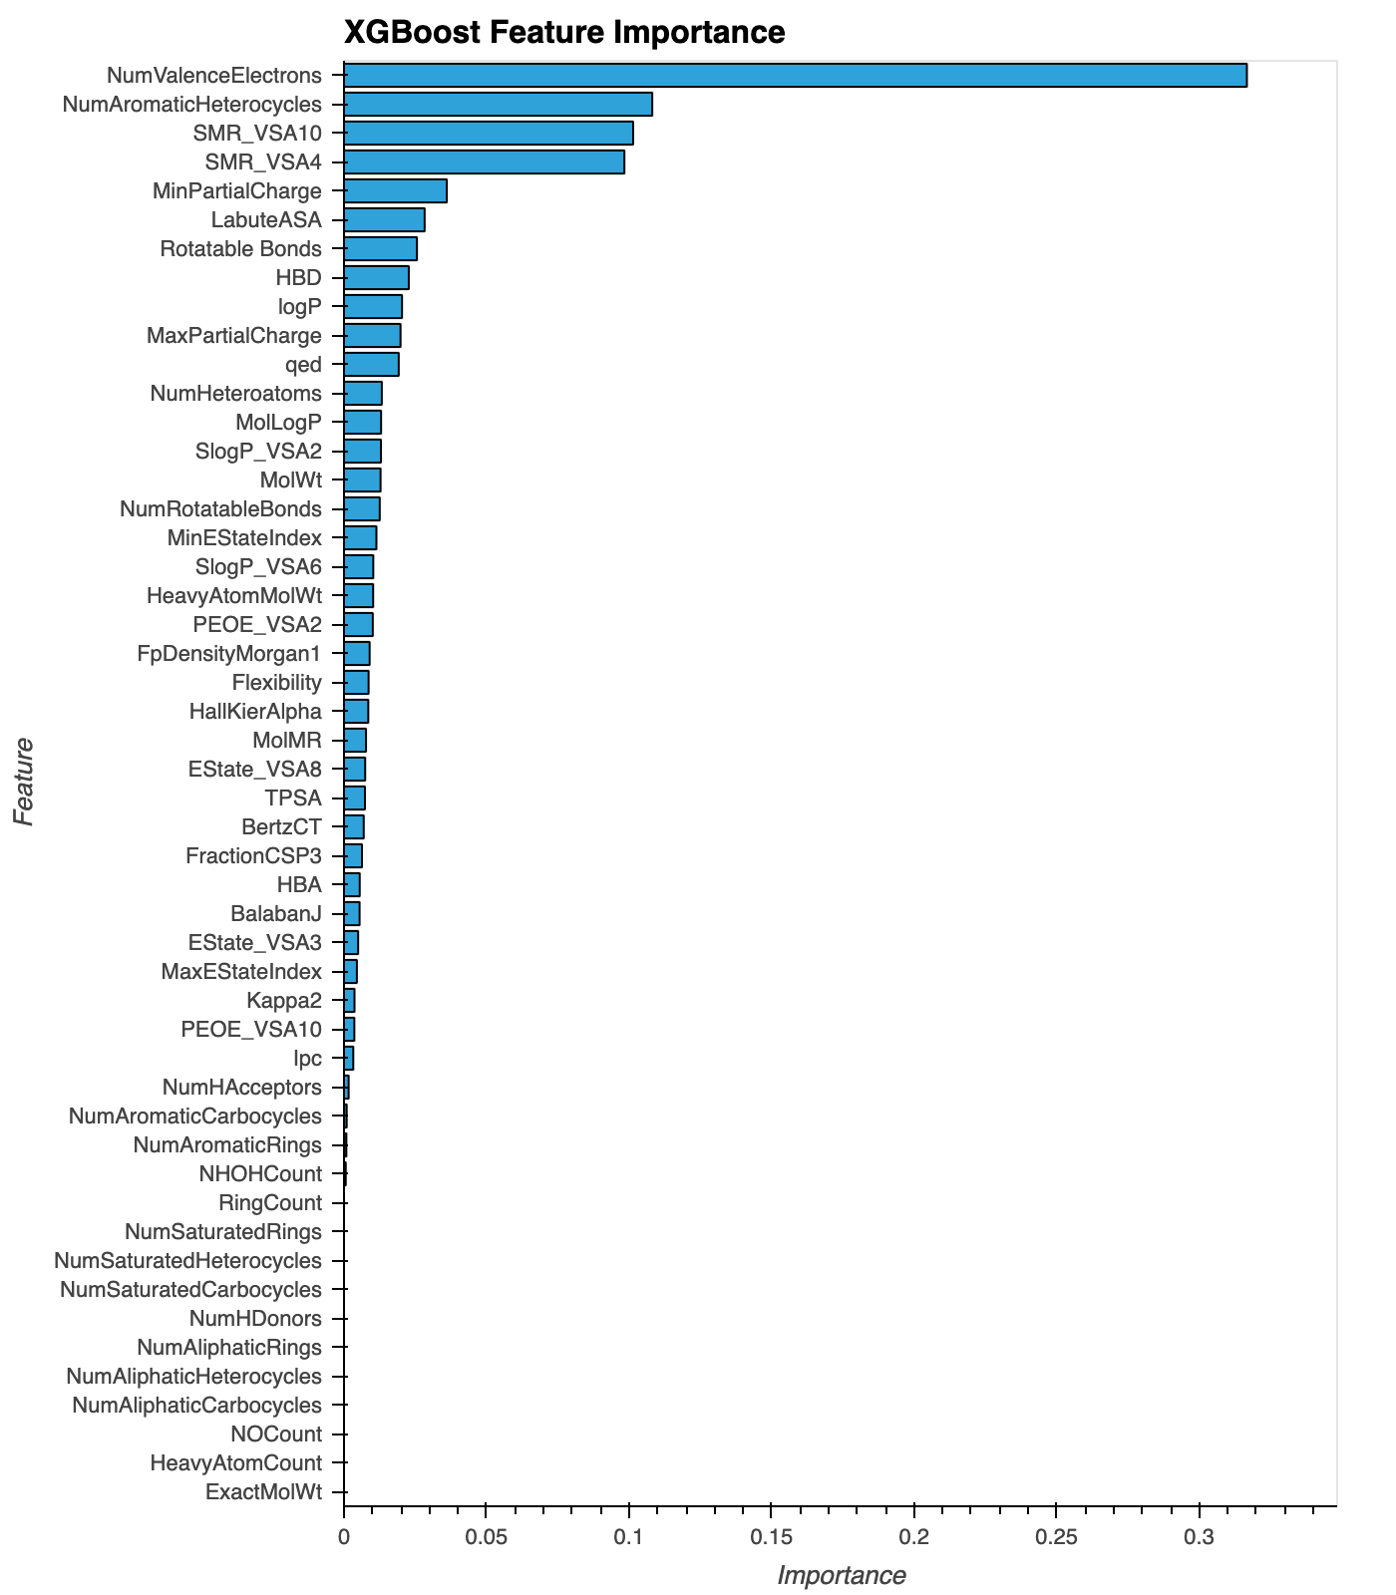

Slide 12
Questions?

